Slide 1
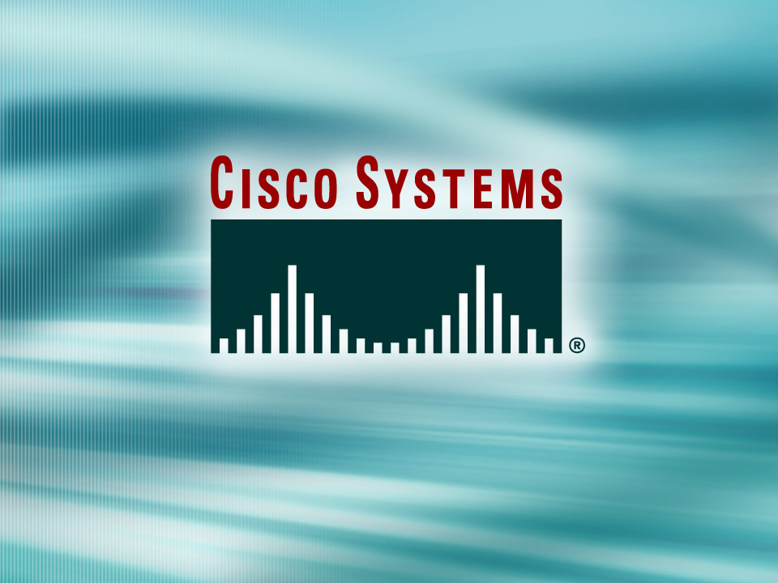
© 2002, Cisco Systems, Inc. All rights reserved.

Slide 2

Getting Information About Remote Devices
© 2002, Cisco Systems, Inc. All rights reserved.
Notes:
Purpose: This chapter introduces the Cisco IOS™ CLI on the Catalyst® 1900 switch and router.
Timing: This chapter should take about 2 hours to present.
Note: The Catalyst 1900 switch only has a subset of the router Cisco IOS commands available.
Contents:
Introduction to Cisco IOS. Explain to the student what is IOS?
Cisco Device startup procedures in general.
IOS configuration source.
General introduction to the IOS CLI.
Cat 1900 switch startup procedures.
Intro to Cat 1900 CLI. This part covers the basic configuration on the switch, like setting the IP address and hostname. More details about the various Cat 1900 switch configuration commands are explained in Chapter 6 and 7.
Router startup procedures. More details on the router startup process is discussed in chapter 5.
Router IOS CLI.

Slide 3
Objectives
Upon completing this lesson, you will be able to:
  Use Telnet to connect to remote network devices, given operational access layer switches and routers
  Use IOS commands to manage the Telnet sessions, given operational access layer switches and routers
Notes:
Slide 1 of 2
Purpose: This slide states the chapter objectives.
Emphasize: Read or state each objective so that each student has a clear understanding of the chapter objectives.
Note: Catalyst switches have different CLIs. The Catalyst 2900xl and the Catalyst 1900 has a Cisco IOS CLI. The Cisco IOS CLI commands available on the 2900xl is different from the 1900. The Catalyst 5000 family has no Cisco IOS CLI, and use the set commands instead. This class only covers the configuration on the Catalyst 1900 switch.

Slide 4
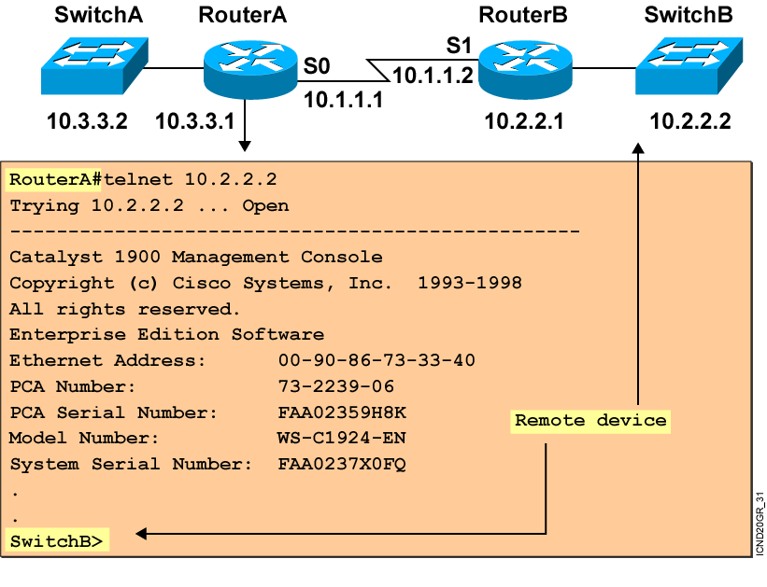
Using Telnet to Connect to Remote Devices
Notes:
Emphasize: Another way to learn about a remote device is to connect to it. Telnet, a virtual terminal protocol that is part of the TCP/IP protocol suite, allows connections to remote hosts. By default, a router can have up to five simultaneous incoming Telnet sessions. With Cisco’s implementation of TCP/IP, you need not enter the connect or telnet command to establish a Telnet connection. If you prefer, you can just enter the learned host name, and the router will resolve the host name using DNS or a local host table. To end a Telnet session, use the exit or logout EXEC command.
These are alternate commands for the operations listed on the graphic:
Initiate a session:
Denver> connect paris
Denver> paris
Denver> 131.108.100.152
Resume a session (enter session number or name):
Denver> 1
Paris>
End a session:
Paris> exit
Note: The Catalyst 1900 can accept incoming Telnet connections but cannot initiate an outgoing Telnet session.

Slide 5
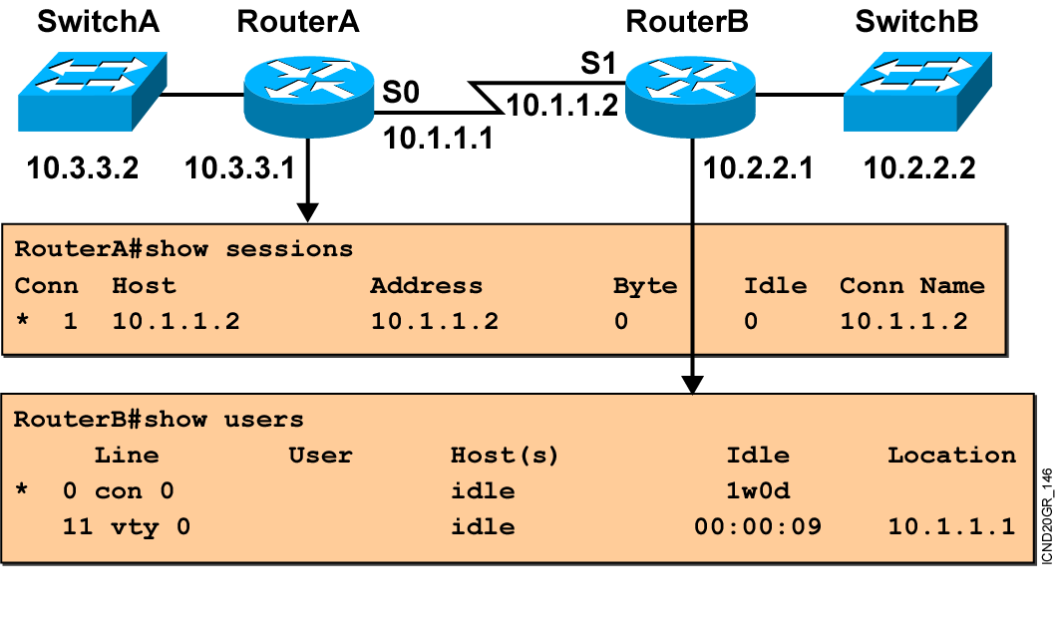
Viewing Telnet Connections
Notes:
Note: This output was taken from a 2522. Line 11 = vty 0.
You can send messages to one or all terminal lines. A common reason for doing this is to inform users of an impending shutdown. To send a message to other terminals, issue the following command:
send {line-number | *}
where line-number specifies the line number to which the message will be sent, and * indicates that the message will be sent to all lines.
The system prompts for the message, which can be up to 500 characters long. End the message by entering Ctrl-Z. Enter Ctrl-C to abort the command.

Slide 6
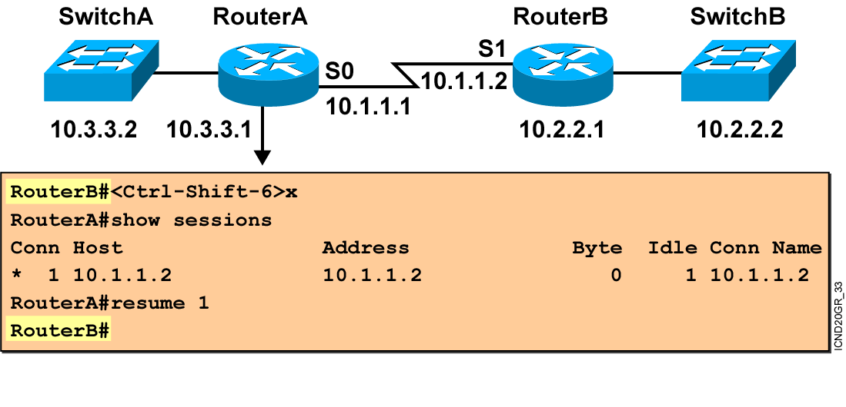
Suspending and Resuming a Telnet Session
Notes:
Emphasize: The key stroke sequence for Ctrl-Shift-6 and x.

Slide 7
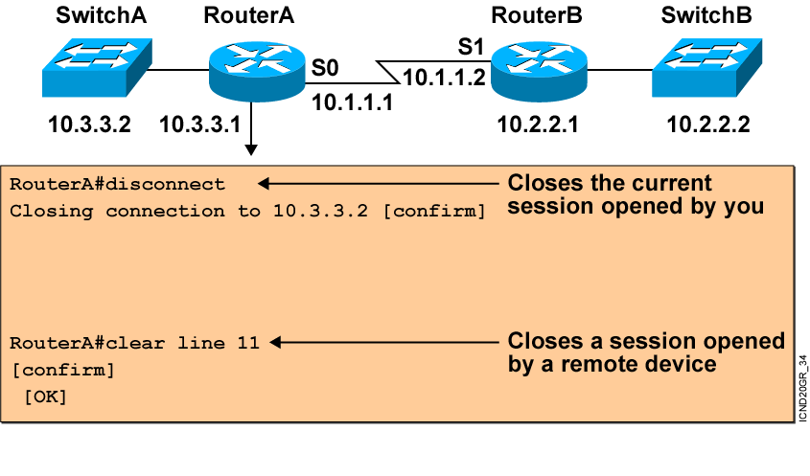
Closing a Telnet Session
Notes:
Note: Disconnecting without the session number disconnects that last active session.

Slide 8
Using the ping and trace Commands
Router###ping 10.1.1.10
Type escape sequence to abort.
Sending 5, 100-byte ICMP Echos to 10.1.1.10, timeout is 2 seconds:
!!!!!
Success rate is 100 percent (5/5), round-trip min/avg/max = 4/4/4 ms
Router#trace 192.168.101.101
Type escape sequence to abort.
Tracing the route to 192.168.101.101
1 p1r1 (192.168.1.49) 20 msec 16 msec 16 msec
2 p1r2 (192.168.1.18) 48 msec * 44 msec
Router#
Tests the connectivity and path to a remote device
Notes:
Emphasize: As you use CDP and Telnet, you should note the information retrieved from the devices you successfully contacted. Documenting that information helps put the network into a visual perspective, and can be referenced at a later time.
This concludes the network discovery portion of the chapter. In the next section, we will discuss configuration file and Cisco IOS image management.

Slide 9
Summary
  The Telnet application is useful for obtaining information about remote devices that aren’t
  accessible by CDP.
  Once connected to a remote device, you may want to access your local device without terminating the Telnet session. Telnet allows you to temporarily suspend and then resume a remote session.
  You can end a Telnet session on a Cisco device using the exit, logout, disconnect, or clear command.
  The ping and trace commands provide information about the connectivity with and path to remote devices.
Notes:
Purpose: This slide discuss the initial configurations on the routers and switches.
Note: There is no setup mode on the Catalyst 1900 switch.

Slide 10


